Slide 1

Blood Bank Management for IITS
Submitted By:
Shariful Islam Atik
ID 20303037
Course: CSC-470(B)
Submitted to:
Fahiba Farhin
Senior Lecturer, IUBAT
Dept of cse

Slide 2
Contents
Overview
Objectives
Scope of the project
Requirement Analysis
User Story Creation
Use Case Diagram
Activity Diagram
Class Diagram
CRC Card
Project planning & Scheduling
Testing
Front-End Design
Conclusion

Slide 3
Overview of System
The Blood Bank Management System for IITS is a software solution that streamlines blood bank operations, focusing on the roles of administrators, Executive donors, and acceptors or patients.
Empowers administrators with tools for user management, blood inventory tracking, and comprehensive reporting and analytics.
Provides donors with a user-friendly experience for registration, appointment scheduling, health screening, and tracking donation history.
:Simplifies blood request submission, status tracking, appointment scheduling, and feedback provision for acceptors, ensuring efficient blood supply management.
BBMS optimizes blood bank operations by enhancing efficiency, transparency, and collaboration among administrators, donors, and acceptors.

Slide 4
Objectives of the System
Efficient Donor Management
Blood Inventory Management
Enhanced Administrative Capabilities
Smooth Checking availability of blood
Easily Find the available donor

Slide 5
Requirement Analysis
Requirement Name | Requirement Description
Registration of Donor | Requires an interface for the registration the details of the donor.
Donor Details
Health Information | Body Weight, Pulse Rate, Haemoglobin, Weight of Bag, Blood Pressure, Temperature Rys
Blood Bank | Requires an interface to display the details of the blood bank.
Donation Details | Blood Group, Number of Bags, Donation Date
Login | Requires 2 Interfaces for login, Change of Password and Password Recovery. Email, Password, New Password.

Slide 6
User Story Creation
As a blood bank Administrator,
I want to manage blood inventory effectively
So that I can ensure timely availability of blood products for patients in need.
Acceptance Criteria:
The application's UI should be user-friendly and
intuitive.
Inventory management features should allow
for easy tracking, ordering, and donation
management.
Importance: Administrators are essential stakeholders in a web-based blood bank management system, responsible for overseeing inventory management, ensuring regulatory compliance, facilitating inter-location transfers, generating reports, providing user support, and coordinating emergency response efforts. Their role is critical in ensuring the efficient and effective operation of the blood bank to meet the needs of patients and healthcare providers.
Estimated Time: 3-4 days

Slide 7
User Story Creation Cont’d
As a blood bank User
I want to be able to search for specific blood types and
products quickly and efficiently.
So that I can easily locate the blood products needed for
patient transfusions and medical procedures.
Acceptance Criteria:
System allows users to search for specific blood types of products.
Users receive timely alerts and notifications via email or within the system for low inventory levels, approaching expiry dates, or recalls.
.
Importance: Users are integral to the success of a blood bank management system, contributing to its development, usability, data integrity, compliance, emergency response, continuous improvement, and community engagement. Their active involvement and collaboration are essential for ensuring the effectiveness, efficiency, and ethical use of the system in managing blood inventory and donor information.
Estimated time: 1-2 days

Slide 8
User Story Creation Cont’d
As a volunteer in a blood bank management system,
I want to contribute effectively to the blood donation process
So that I can support the needs of patients and positively impact the community.
Acceptance Criteria:
The volunteer can actively participate in donor recruitment activities such as organizing blood drives, community events, or outreach programs.
The volunteer accurately registers eligible donors into the system, capturing essential information for donation records.
In emergency or disaster situations, the volunteer is available to provide support in mobilizing blood donations and coordinating donation efforts.
Importance : Volunteers are indispensable partners in the operation of blood banks and their management systems. Their contributions extend beyond the donation of blood to encompass donor recruitment, donor care, community engagement, and emergency response efforts, all of which are essential for ensuring a safe, sustainable, and sufficient blood supply forpatients in need.
Estimated time: 2 days

Slide 9
User Story Cont’d
As a blood donor,
I want to donate blood regularly
So that I can contribute to saving lives and supporting healthcare services in my community.
Acceptance criteria:
Given that I am a registered donor, when I log into the blood donation system, I should be able to access my donor profile securely.
Given that I am eligible to donate blood, when I navigate to the appointment scheduling section, I should be presented with available donation slots based on my location and preferences.
Given that my appointment is confirmed, when the donation date approaches, I should receive reminder notifications to ensure I don't miss my appointment.
Importance: Blood donors are integral to the healthcare
system, playing a crucial role in saving lives, addressing
medical needs, supporting emergency preparedness,
promoting community health, raising awareness, and
embodying the values of altruism and compassion. Their
contributions have a profound and lasting impact on
individuals, families, and communities, making them
indispensable heroes in the fight against illness and disease.
Estimated time: 3 to 4 days

Slide 10
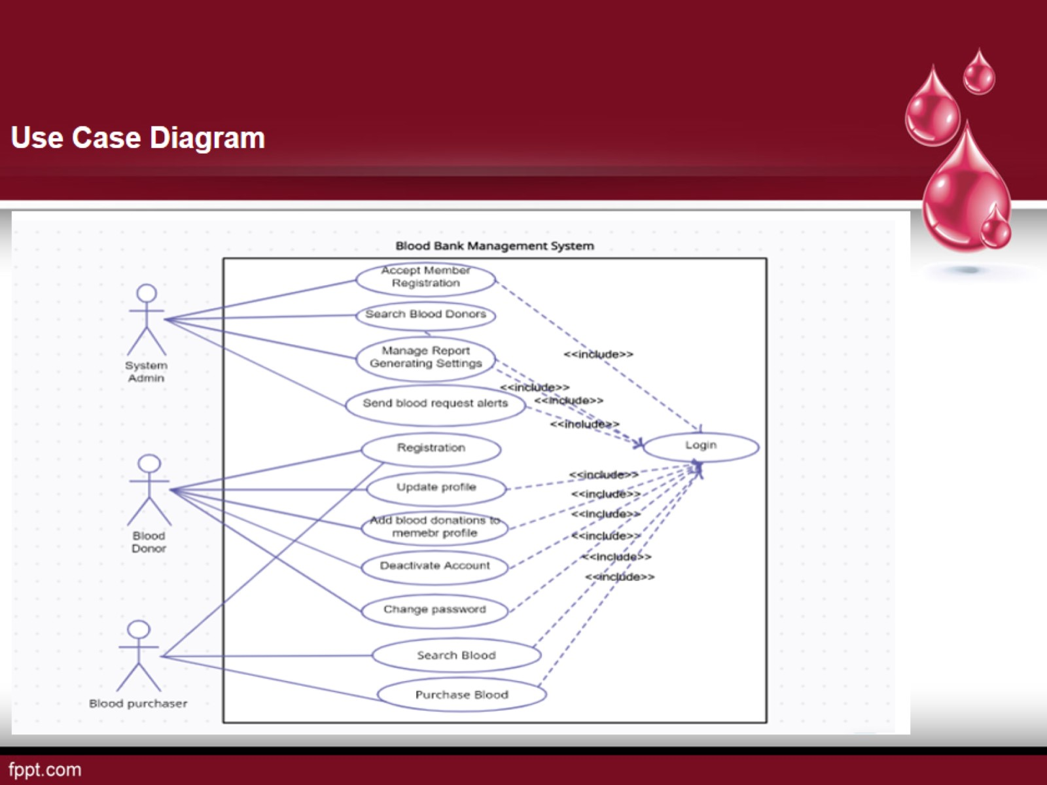
User Case Diagram
Admin
Executive Donor
Acceptor

Slide 11
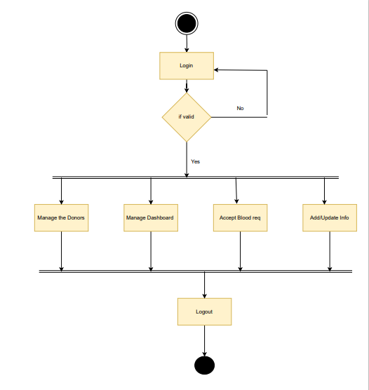
Activity Diagram-Admin

Slide 12
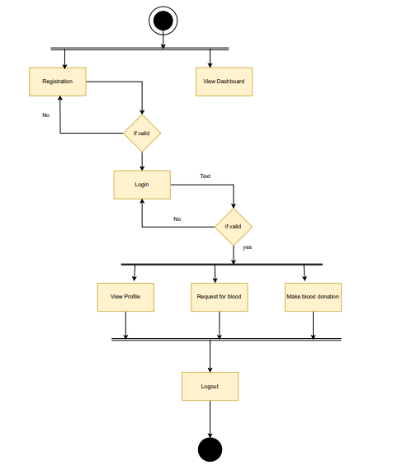
Activity diagram-Executive Donor

Slide 13
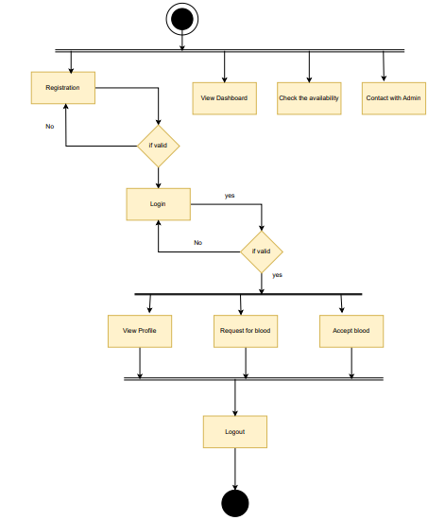
Activity Diagram-Acceptor

Slide 14
CRC Card(Volunteer & Requester)
r
Class Name: Volunteer
Class Type: Structure
Responsibilities Register and log into the system Log blood donations View donation history | Collaborators • System(for authentication and data validation) • Donation(for recording and retrieving donation data)
Class Name: Requester
Class Type: Structure
Responsibilities Register and log into the system Submit blood requests Track request status | Collaborators • System (for authentication and data validation) Request (for submitting and tracking requests)

Slide 15
CRC Card(Admin)
Class Name: Admin
Class Type: Abstract, Persistance, Guarded
Responsibilities Manage user registrations Approve or deny blood requests Generate reports | Collaborators • System (for user management and data validation) Request (for managing blood requests) Report (for generating system reports)

Slide 16
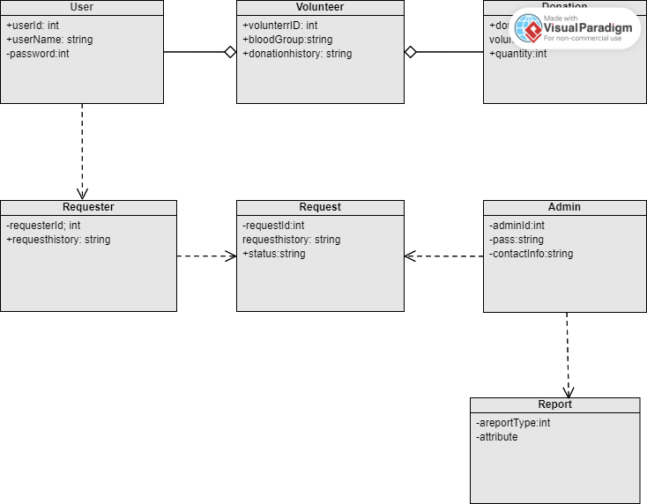
Class Diagram

Slide 17
Project Planning and Scheduling
Function Point Estimation
External Inputs (EI): User inputs to the system (e.g., registration forms, login forms).
External Outputs (EO): Outputs generated by the system (e.g., confirmation emails, status notifications).
External Inquiries (EQ): Interactions where data is retrieved (e.g., donation history view, request status check).
Internal Logical Files (ILF): Files or data stored within the system (e.g., user profiles, donation records).
External Interface Files (EIF): Files used by the system but maintained by other systems (e.g., external databases for blood type verification).

Slide 18
Complexity Weights:
Function | Simple | Average | Complex
El | 3 | 4 | 6
EO | 4 | 5 | 7
EQ | 3 | 4 | 4
ILF | 7 | 8 | 2
EIF | 5 | 3 | 5

Slide 19
Project Scheduling Chart
TaskID | TaskName | Duration | Dependencies
1 | Requirements Collection | 1 weeks
2 | System Design | 3 weeks
3 | Implementation | 4weeks
4 | Testing | 1 weeks
5 | Deployment | 1 weeks
6 | Project Review | 1 weeks

Slide 20
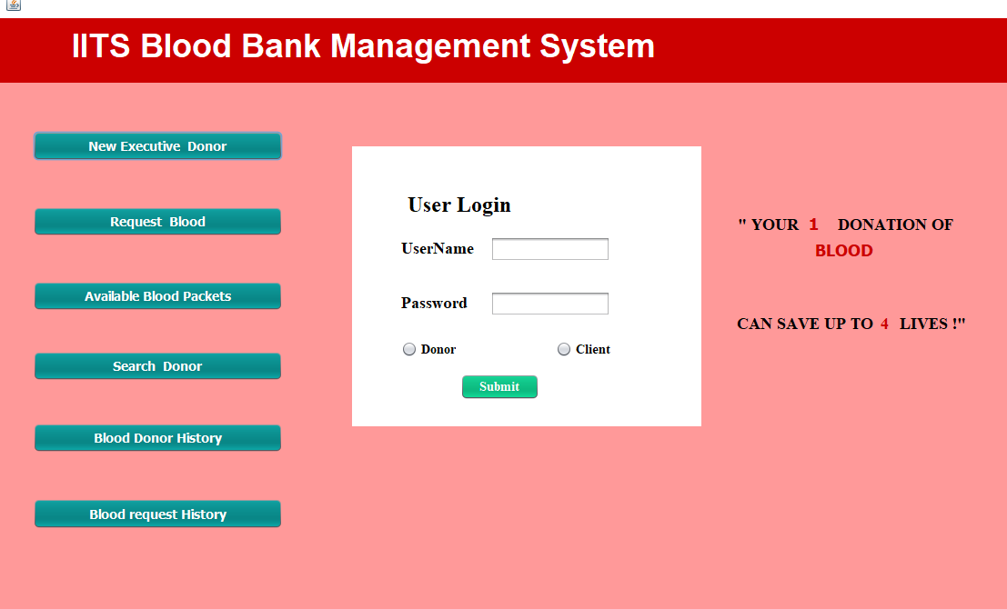
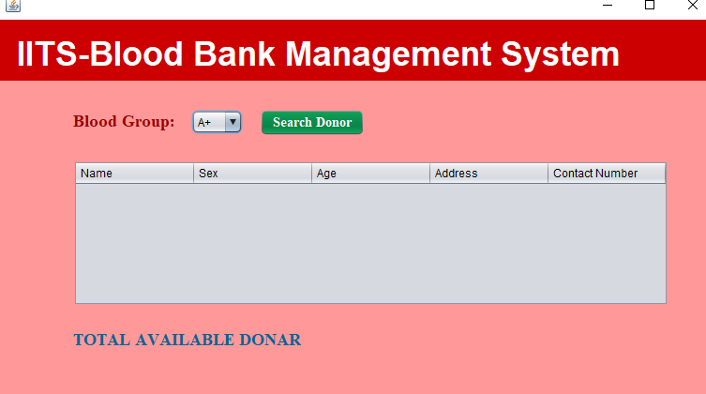
Designing(user interface)

Slide 21
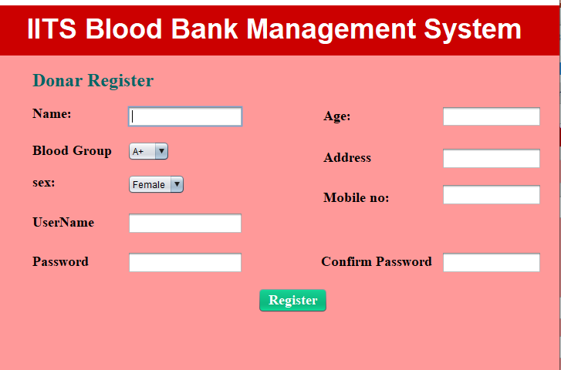
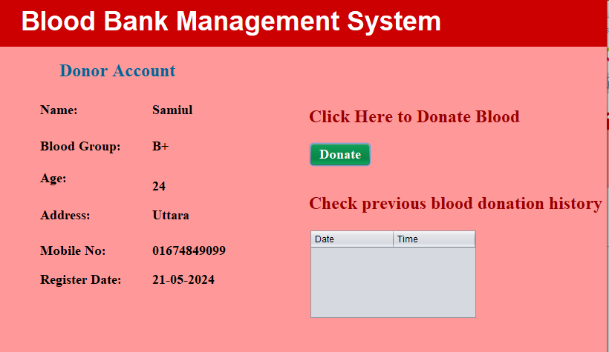
User Interface

Slide 22
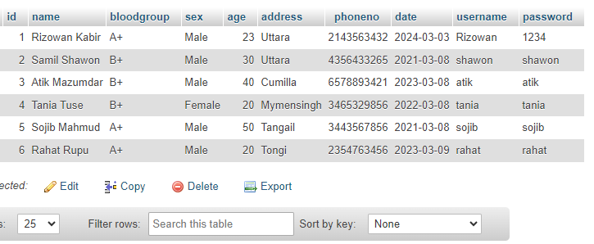
Database

Slide 23
Testing(Volunteer Registration and Login)
Test Case ID | TC-01
Description | Verify that a volunteer can register successfully.
Precondition | The registration form is accessible
Test Steps | 1. Navigate to the registration page. <br> 2. Fill in the required fields (Name, Email, Blood Type, etc.). <br> 3. Click the "Submit" button.
Expected Results | The volunteer receives a confirmation email and a success message is displayed on the screen.
Actual Results | To be filled After Testing
Test Case ID | TC-02
Description | Verify that a volunteer can log in successfully.
Precondition | The volunteer is registered and has valid credentials.
Test Steps | 1. Navigate to the login page. <br> 2. Enter the registered email and password. <br> 3. Click the "Login" button.
Expected Results | The volunteer is redirected to the dashboard.
Actual Results | To be filled after testing

Slide 24
Testing(donationLogin & request submission)
Test Case ID | TC-03
Description | Verify that a volunteer can log in successfully.
Precondition | The volunteer is registered and has valid credentials.
Test Steps | 1. Navigate to the login page. <br> 2. Enter the registered email and password. <br> 3. Click the "Login" button.
Expected Results | The volunteer is redirected to the dashboard.
Actual Results | The volunteer is redirected to the dashboard.
(To be filled after testing) | To be filled after testing
Test Case ID | TC-04
Description | Verify that a volunteer can log a blood donation.
Precondition | The requester is logged in
Test Steps | The requester is logged in
Expected Results | The donation details are saved, and a confirmation message is displayed.
Actual Results | The donation details are saved, and a confirmation message is displayed.
to be filled after testing | To be filled after testing

Slide 25
Conclusion
The Blood Bank Management System for the IUBAT IT Society is designed to streamline the process of blood donation and requests. This system allows volunteers to register and log their blood donations while providing an easy interface for individuals to request blood.
The admin panel enables efficient management of users, donations, and requests, ensuring a smooth operation.
The project leverages open-source technologies to stay within budget constraints and aims to provide a secure, user-friendly platform to manage blood bank activities.

Slide 26

?

